Slide 1
Chapter 17 - C++ Classes: Part II
Outline
17.1 Introduction
17.2 const (Constant) Objects and const Member Functions
17.3 Composition: Objects as Members of Classes
17.4 friend Functions and friend Classes
17.5 Using the this Pointer
17.6 Dynamic Memory Allocation with Operators new and delete
17.7 static Class Members
17.8 Data Abstraction and Information Hiding
17.8.1 Example: Array Abstract Data Type
17.8.2 Example: String Abstract Data Type
17.8.3 Example: Queue Abstract Data Type
17.9 Container Classes and Iterators

Slide 2
Objectives
In this chapter, you will learn:
  To be able to create and destroy objects dynamically.
  To be able to specify const (constant) objects and const member functions.
  To understand the purpose of friend functions and friend classes.
  To understand how to use static data members and member functions.
  To understand the concept of a container class.
  To understand the notion of iterator classes that walk through the elements of container classes.
  To understand the use of the this pointer.

Slide 3
17.1 Introduction
Chapters 16-18
  Object-based programming
Chapter 19-20
  Polymorphism and inheritance
  Object-oriented programming

Slide 4
17.2 const (Constant) Objects and const Member Functions
Principle of least privilege
  Only give objects permissions they need, no more
Keyword const
  Specify that an object is not modifiable
  Any attempt to modify the object is a syntax error
  For example:
const time noon( 12, 0, 0 );
  Defines a const object noon of class time and initializes it to 12 noon

Slide 5
17.2 const (Constant) Objects and const Member Functions (II)
const objects require const functions
  Functions declared const cannot modify the object
  const specified in function prototype and definition
  Prototype: ReturnType FunctionName(param1,param2…) const;
  Definition: ReturnType FunctionName(param1,param2…) const { …};
  Example:
  int A::getValue() const
  {return privateDataMember};
  Returns the value of a data member, and is appropriately declared const
Constructors / Destructors cannot be const
  They need to initialize variables (therefore modifying them)

Slide 6
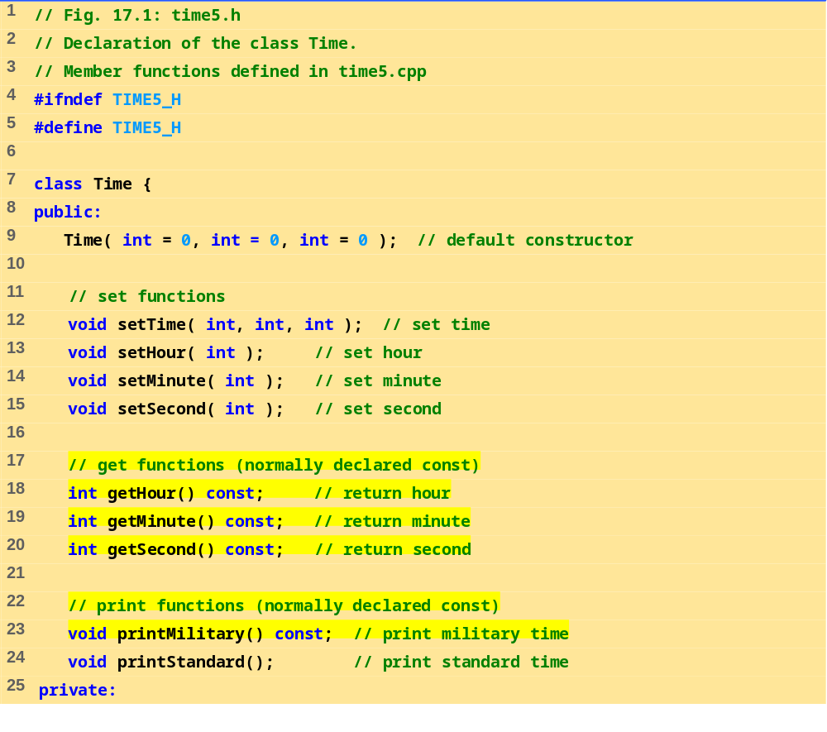
times.h (Part 1 of 2)

Slide 7
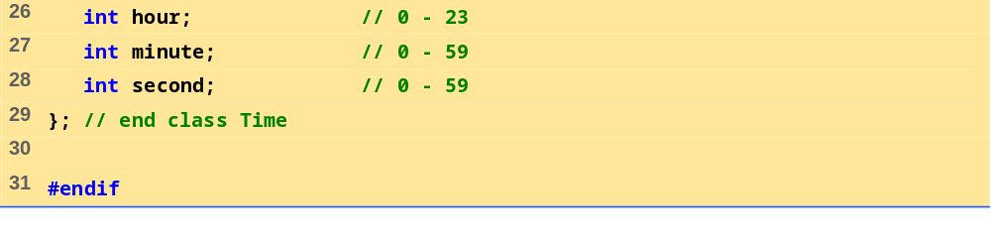
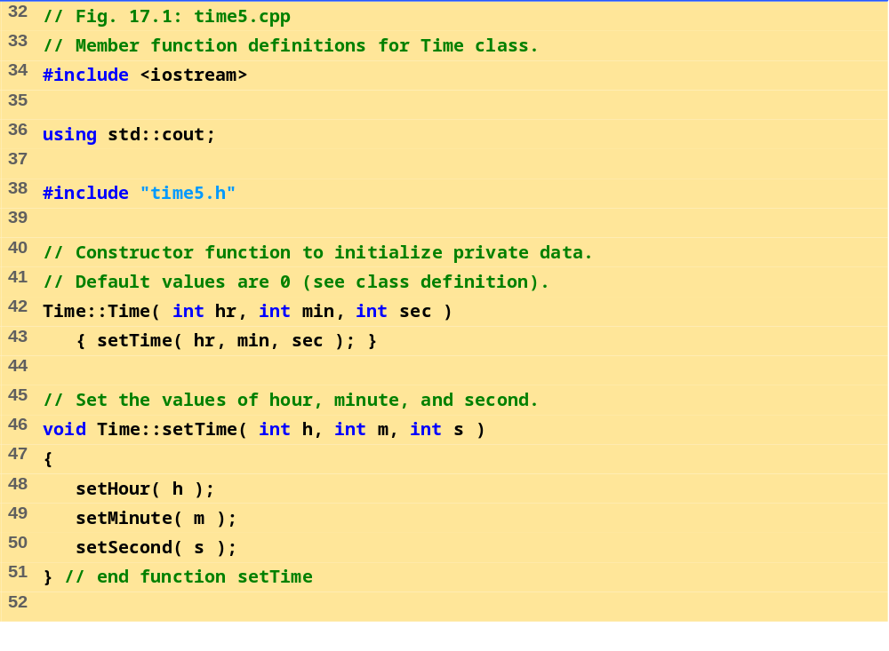
time.h (Part 2 of 2)
time5.h (Part 1 of 3)

Slide 8
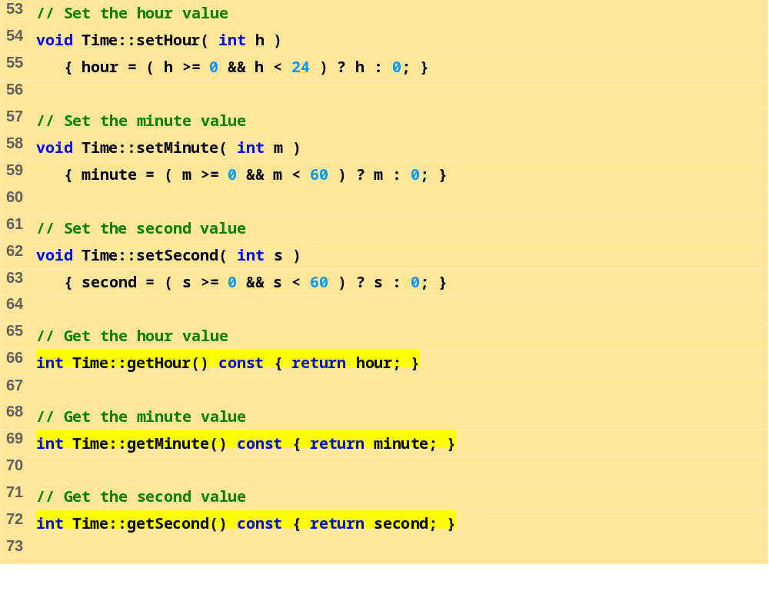
time5.h (Part 2 of 3)

Slide 9
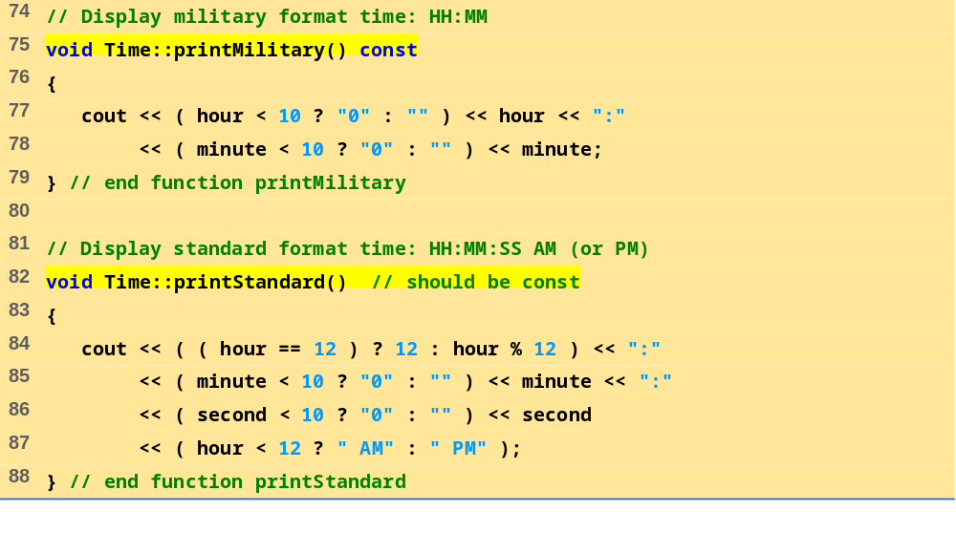
time5.h (Part 3 of 3)

Slide 10
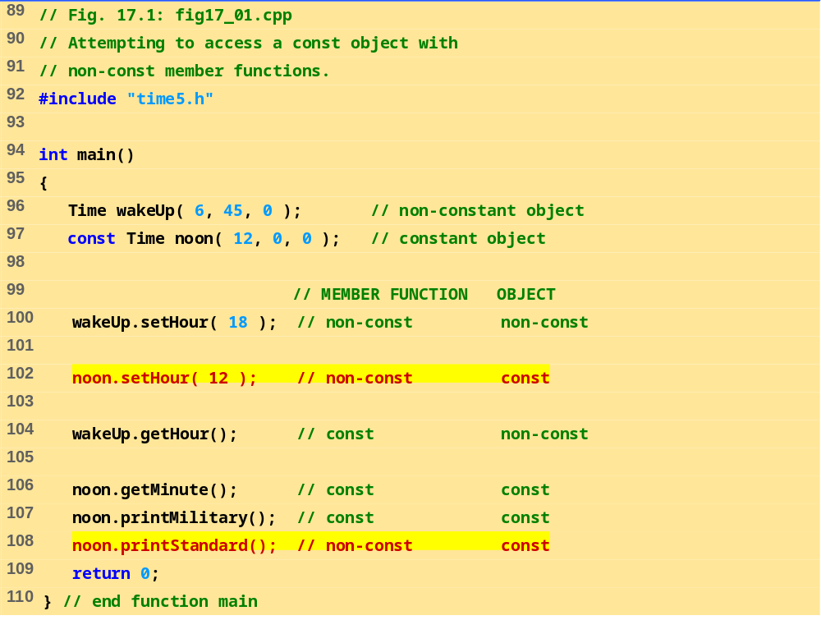
fig17_01.cpp

Slide 11
Compiling...
Fig17_01.cpp
d:fig17_01.cpp(14) : error C2662: 'setHour' : cannot convert 'this' pointer from 'const class Time' to 'class Time &'
Conversion loses qualifiers
d:\fig17_01.cpp(20) : error C2662: 'printStandard' : cannot convert 'this' pointer from 'const class Time' to 'class Time &'
Conversion loses qualifiers
Time5.cpp
Error executing cl.exe.
test.exe - 2 error(s), 0 warning(s)
Program Output

Slide 12
17.2 const (Constant) Objects and const Member Functions (III)
Member initializer syntax
  Data member increment in class Increment.
  Constructor for Increment is modified as follows:
Increment::Increment( int c, int i )
: increment( i )
{ count = c; }
  ": increment( i )" initializes increment to the value of i.
  Any data member can be initialized using member initializer syntax
  consts and references must be initialized this way
Multiple member initializers
  Use comma-separated list after the colon

Slide 13
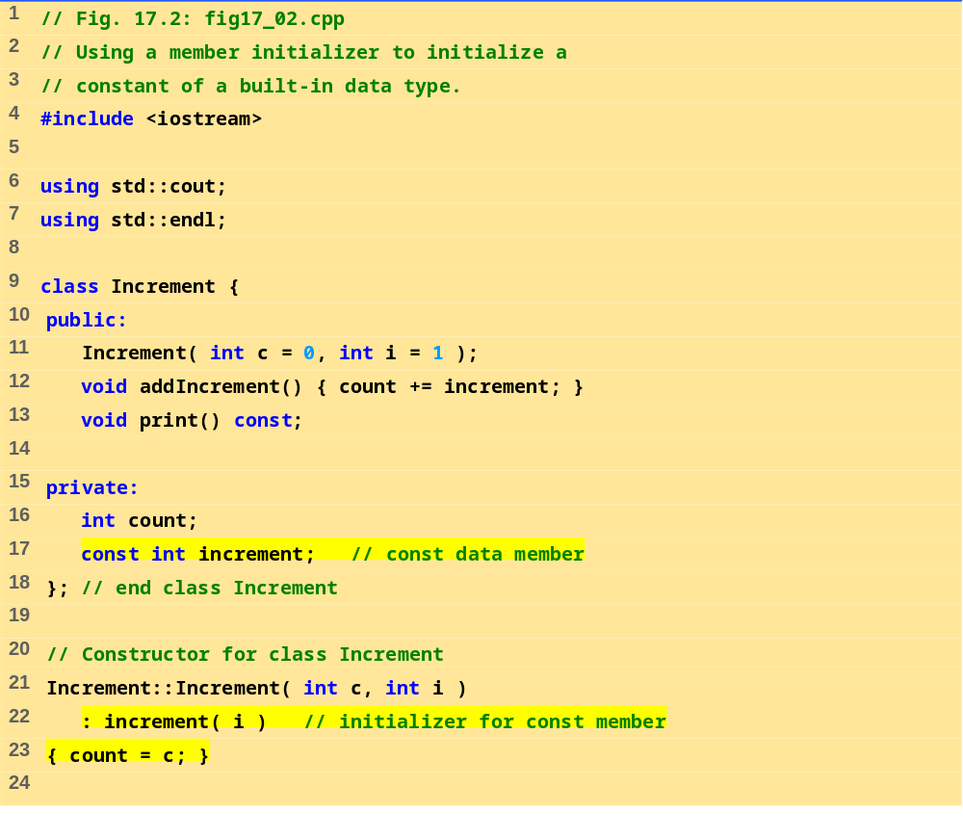
fig17_02.cpp (Part 1 of 2)

Slide 14
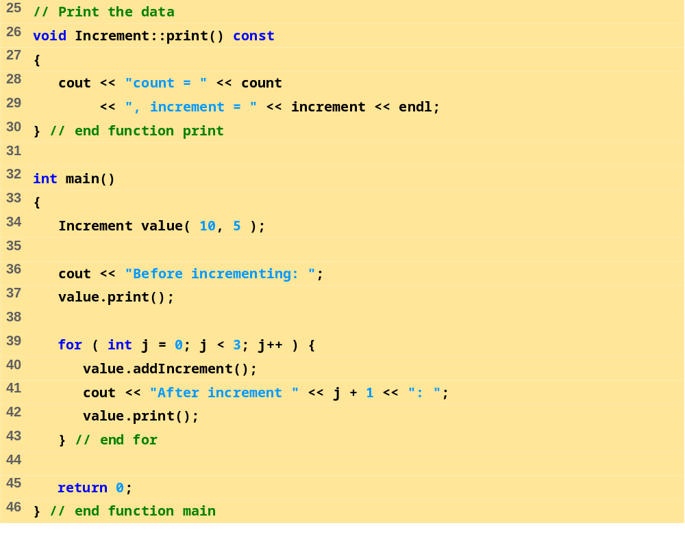
fig17_02.cpp (Part 2 of 2)
Program Output
Before incrementing: count = 10, increment = 5
After increment 1: count = 15, increment = 5
After increment 2: count = 20, increment = 5
After increment 3: count = 25, increment = 5

Slide 15
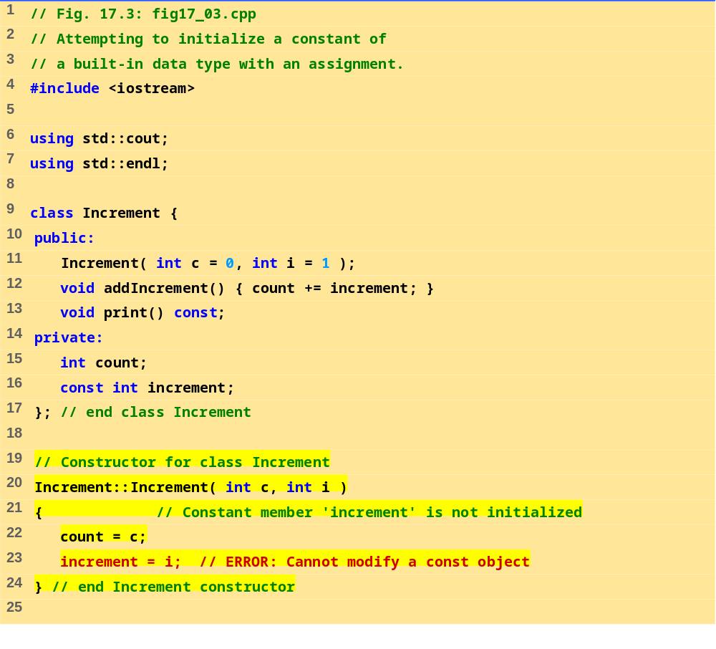
fig17_03.cpp (Part 1 of 2)

Slide 16

fig17_03.cpp (Part 1 of 2)

Slide 17
Compiling...
Fig17_03.cpp
D:\Fig17_03.cpp(21) : error C2758: 'increment' : must be initialized in constructor base/member initializer list
D:\Fig17_03.cpp(16) : see declaration of 'increment'
D:\Fig17_03.cpp(23) : error C2166: l-value specifies const object
Error executing cl.exe.
test.exe - 2 error(s), 0 warning(s)
Program Output

Slide 18
17.3 Composition: Objects as Members of Classes
Composition
  Class has objects of other classes as members
Construction of objects
  Member objects constructed in order declared
    Not in order of constructor’s member initializer list
  Constructed before their enclosing class objects (host objects)
  Constructors called inside out
  Destructors called outside in

Slide 19
17.3 Composition: Objects as Members of Classes (II)
Example:
Employee::Employee( char *fname, char *lname,
int bmonth, int bday, int byear,
int hmonth, int hday, int hyear )
: birthDate( bmonth, bday, byear ),
hireDate( hmonth, hday, hyear )
  Insert objects from Date class (birthDate and hireDate) into Employee class
  birthDate and hireDate have member initializers - they are probably consts in the Employee class

Slide 20
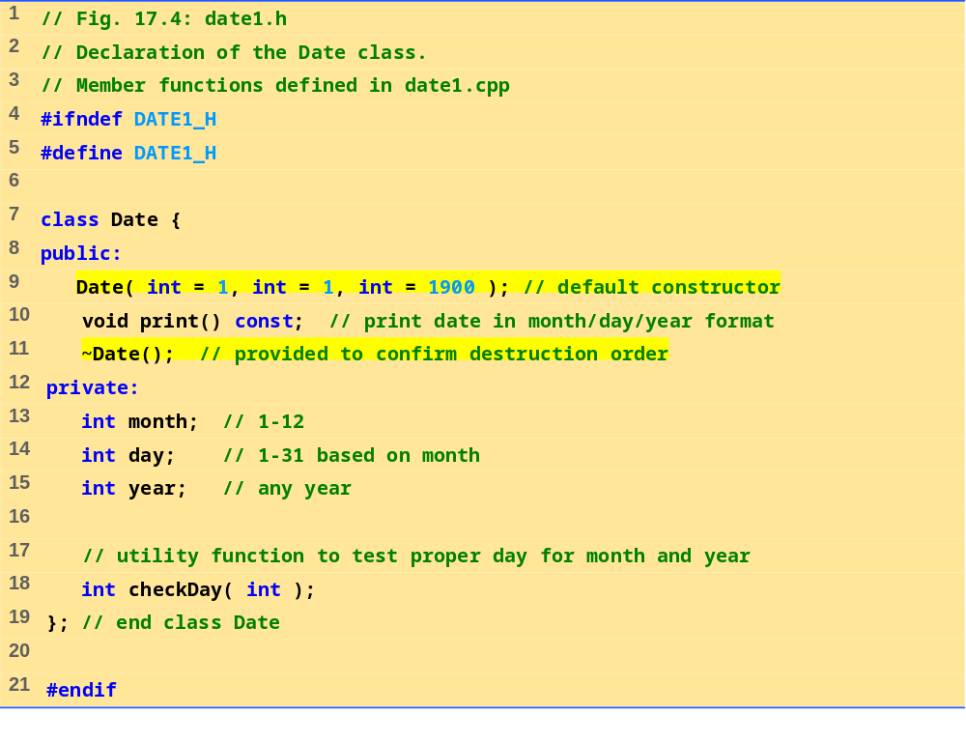
date1.h

Slide 21
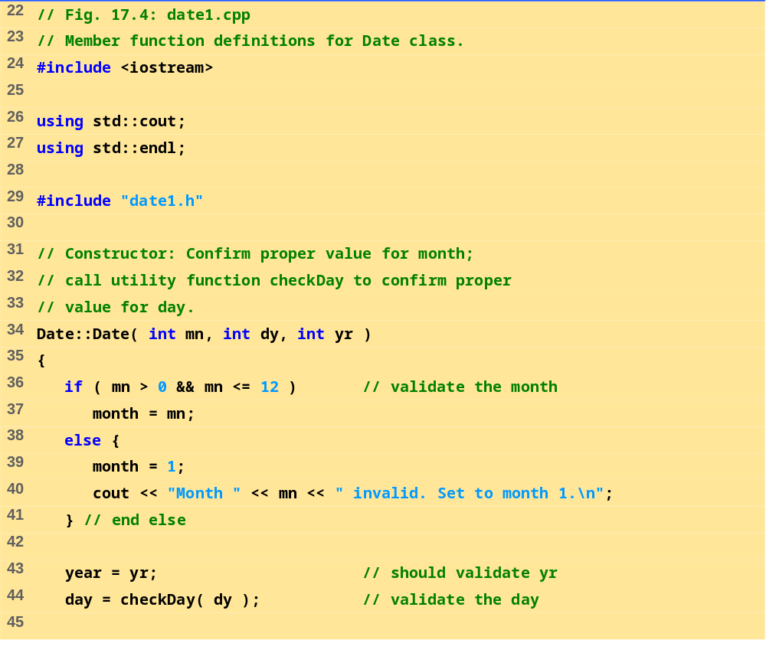
date1.cpp (Part 1 of 3)

Slide 22
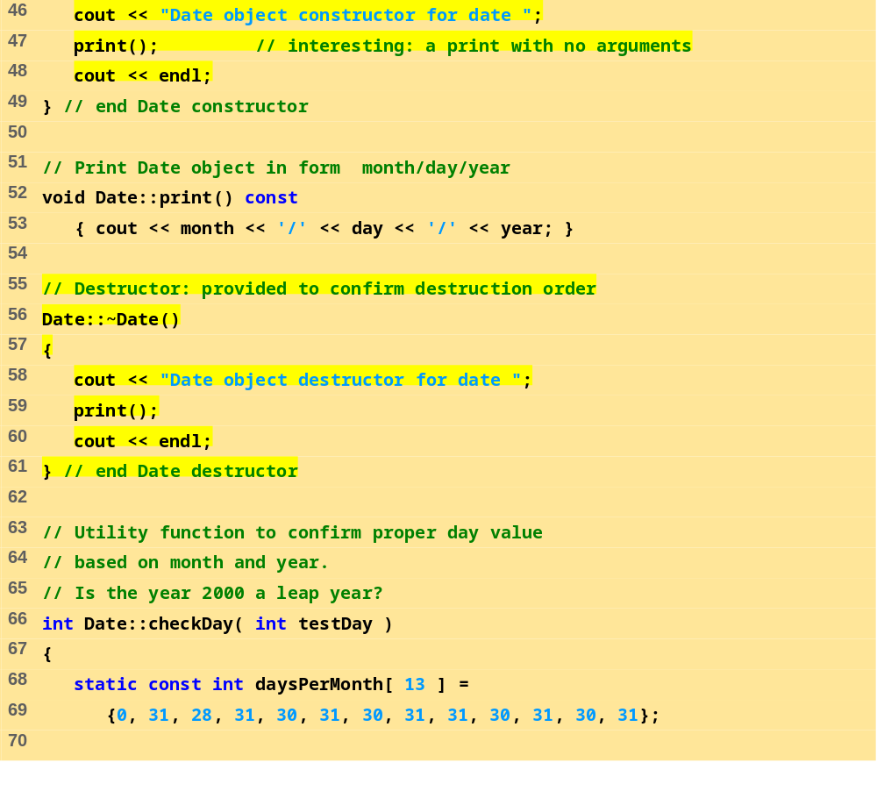
date1.cpp (Part 2 of 3)

Slide 23
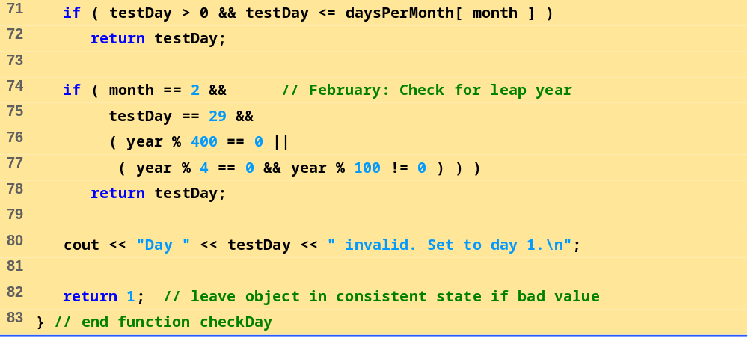
date1.cpp (Part 3 of 3)

Slide 24
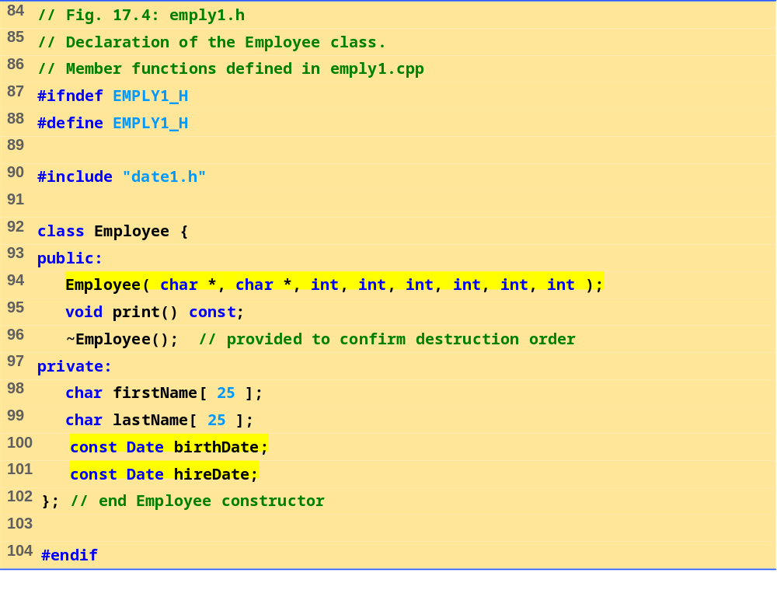
emply1.h

Slide 25
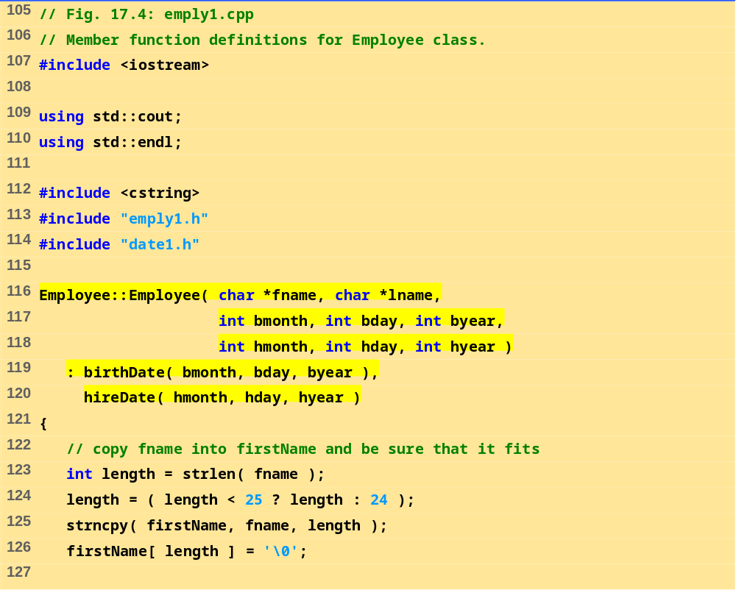
emply1.cpp (Part 1 of 2)

Slide 26
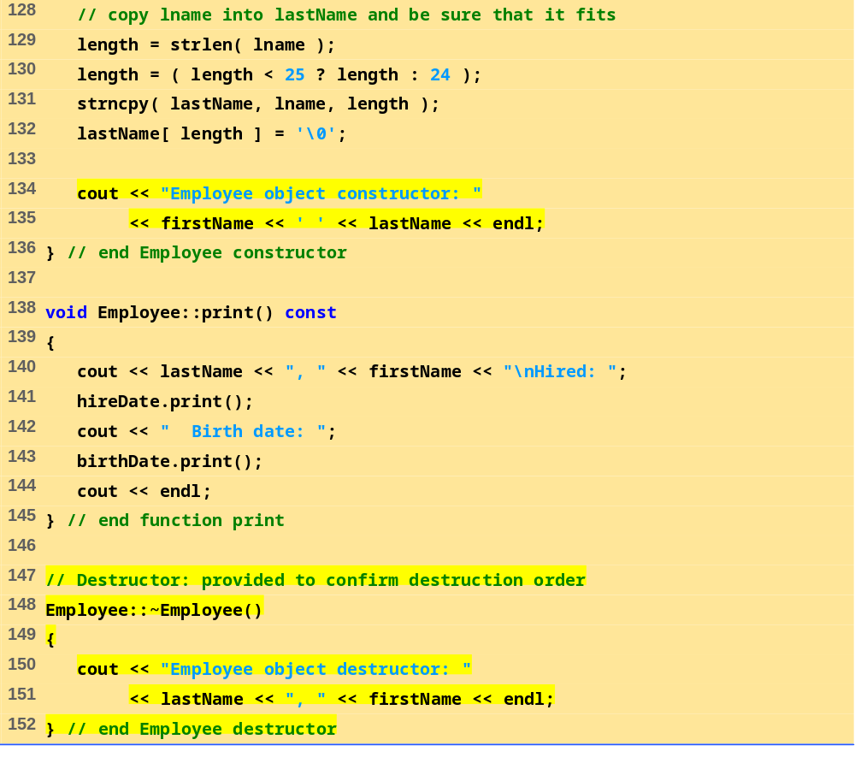
emply1.cpp (Part 2 of 2)

Slide 27
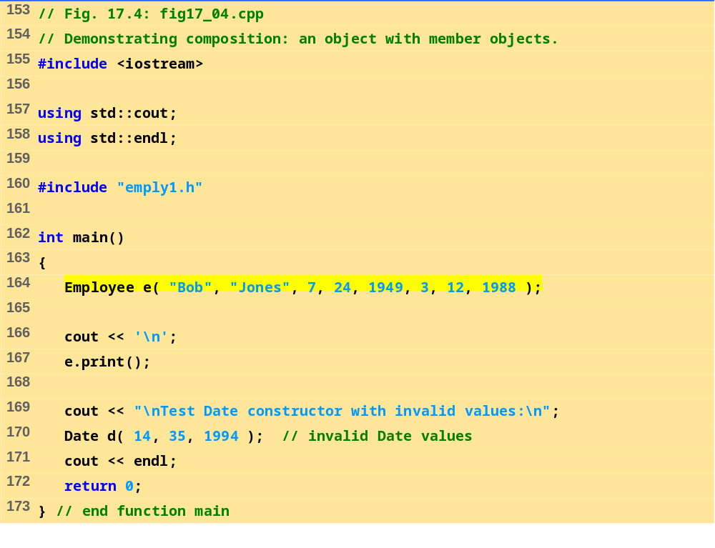
fig17_04.cpp

Slide 28
Date object constructor for date 7/24/1949
Date object constructor for date 3/12/1988
Employee object constructor: Bob Jones
Jones, Bob
Hired: 3/12/1988 Birth date: 7/24/1949
Test Date constructor with invalid values:
Month 14 invalid. Set to month 1.
Day 35 invalid. Set to day 1.
Date object constructor for date 1/1/1994
Date object destructor for date 1/1/1994
Employee object destructor: Jones, Bob
Date object destructor for date 3/12/1988
Date object destructor for date 7/24/1949
Program Output

Slide 29
17.4 friend Functions and friend Classes
friend function and friend classes
  Can access private and protected (more later) members of another class
  friend functions are not member functions of class
    Defined outside of class scope
Properties
  Friendship is granted, not taken
  NOT symmetric (if B a friend of A, A not necessarily a friend of B)
  NOT transitive (if A a friend of B, B a friend of C, A not necessarily a friend of C)

Slide 30
17.4 friend Functions and friend Classes
(II)
friend declarations
  friend function
    Keyword friend before function prototype in class that is giving friendship.
    friend int myFunction( int x );
    Appears in the class granting friendship
  friend class
    Type friend class Classname in class granting friendship
    If ClassOne granting friendship to ClassTwo,
  friend class ClassTwo;
  appears in ClassOne's definition

Slide 31
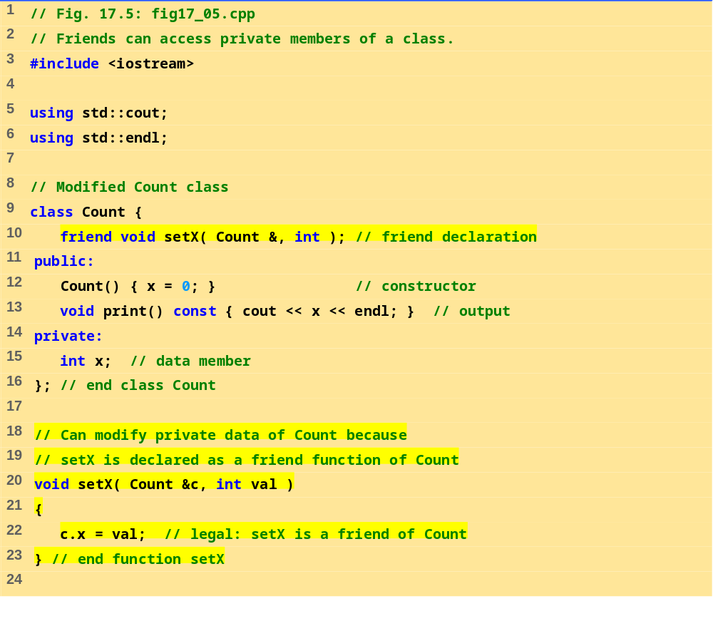
fig17_05.cpp (Part 1 of 2)

Slide 32
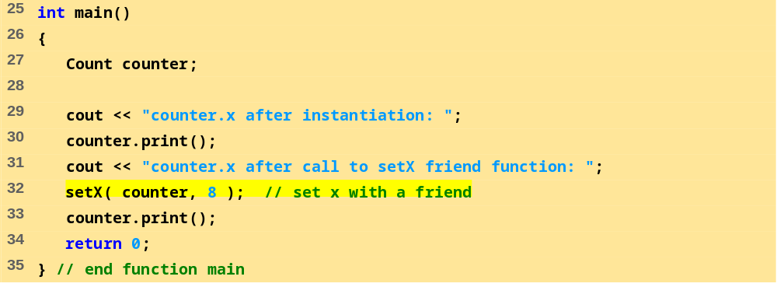
fig17_05.cpp (Part 1 of 2)
Program Output
counter.x after instantiation: 0
counter.x after call to setX friend function: 8

Slide 33
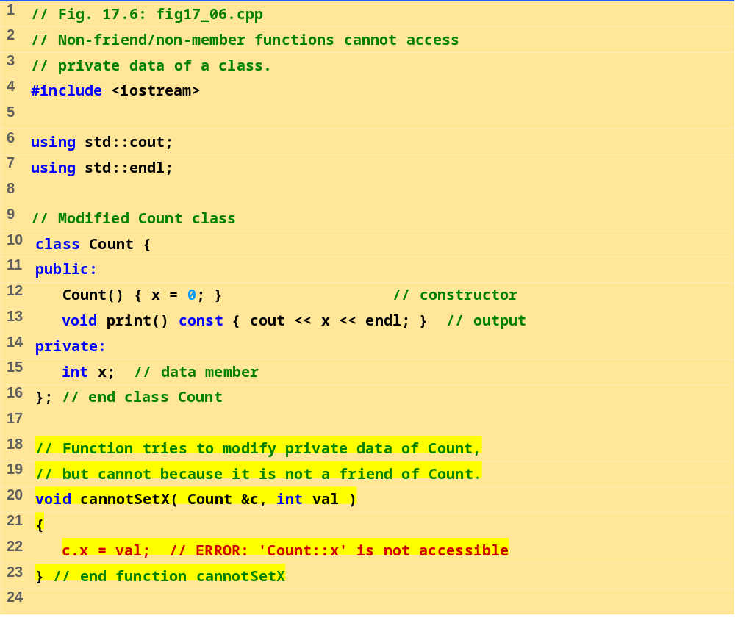
fig17_06.cpp (Part 1 of 2)

Slide 34
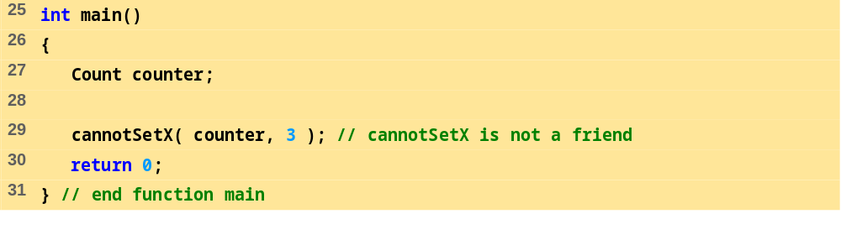
fig17_06.cpp (Part 2 of 2)
Program Output
Compiling...
Fig17_06.cpp
D:\Fig17_06.cpp(22) :
error C2248: 'x' : cannot access private member declared in
class 'Count'
D:\Fig17_06.cpp(15) : see declaration of 'x'
Error executing cl.exe.
test.exe - 1 error(s), 0 warning(s)

Slide 35
17.5 Using the this Pointer
this pointer
  Allows objects to access their own address
  Not part of the object itself
  Implicit first argument on non-static member function call to the object
  Implicitly reference member data and functions
Example: class Employee
  For non-const member functions: type Employee * const
    Constant pointer to an Employee object
  For const member functions: type const Employee * const
    Constant pointer to an constant Employee object

Slide 36
17.5 Using the this Pointer (II)
Cascaded member function calls
  Function returns a reference pointer to the same object
    {return *this;}
  Other functions can operate on that pointer
  Functions that do not return references must be called last

Slide 37
17.5 Using the this Pointer (III)
Example
  Member functions setHour, setMinute, and setSecond all return *this (reference to an object)
  For object t, consider
  t.setHour(1).setMinute(2).setSecond(3);
  Executes t.setHour(1) and returns *this (reference to object), and expression becomes
  t.setMinute(2).setSecond(3);
  Executes t.setMinute(2), returns reference, and becomes
  t.setSecond(3);
  Executes t.setSecond(3), returns reference, and becomes
  t;
  Has no effect

Slide 38
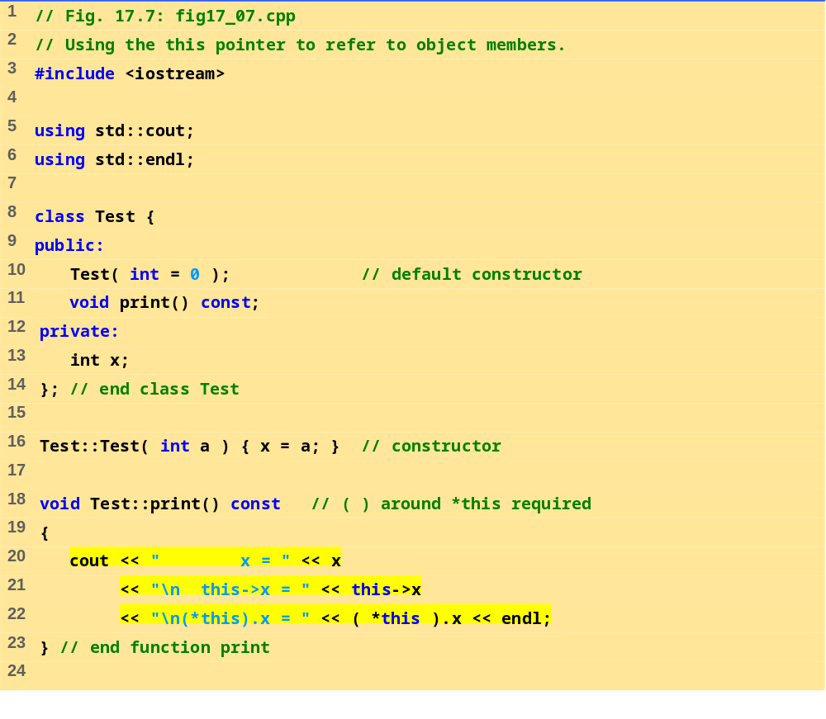
fig17_07.cpp (Part 1 of 2)

Slide 39
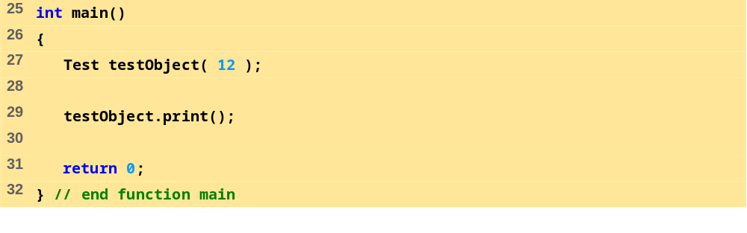
fig17_07.cpp (Part 2 of 2)
x = 12
this->x = 12
(*this).x = 12

Slide 40
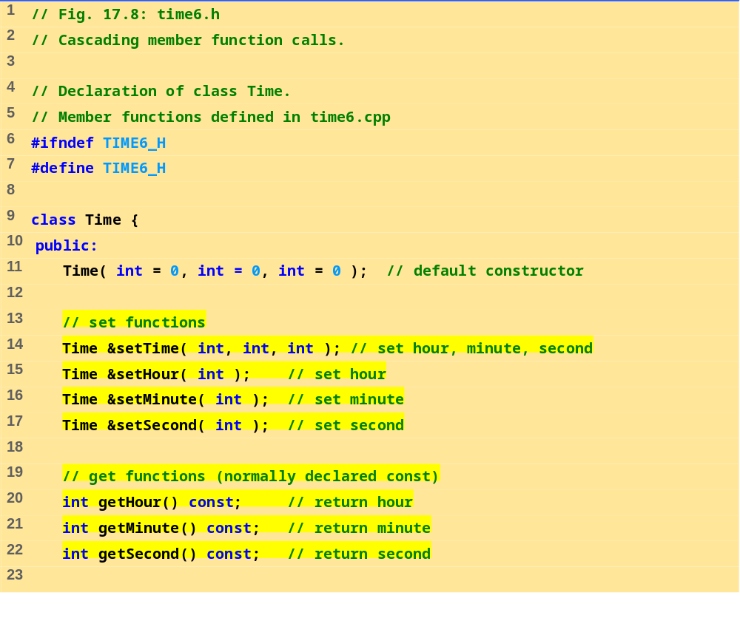
time6.h (Part 1 of 2)

Slide 41
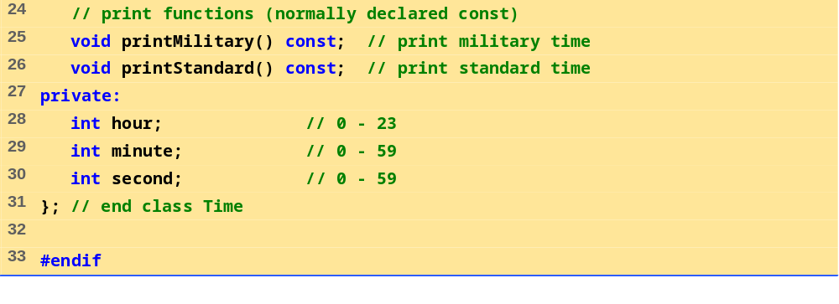
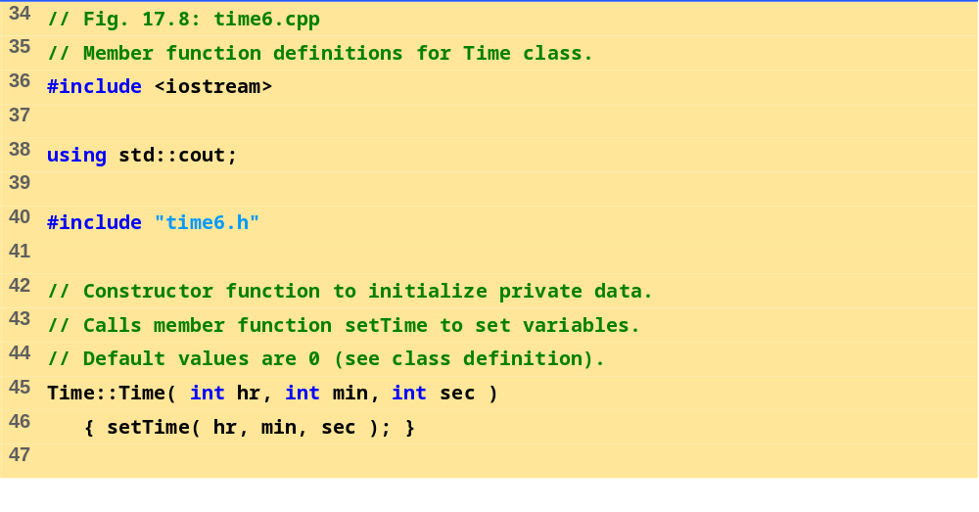
time6.h (Part 2 of 2)
time6.cpp (Part 1 of 3)

Slide 42
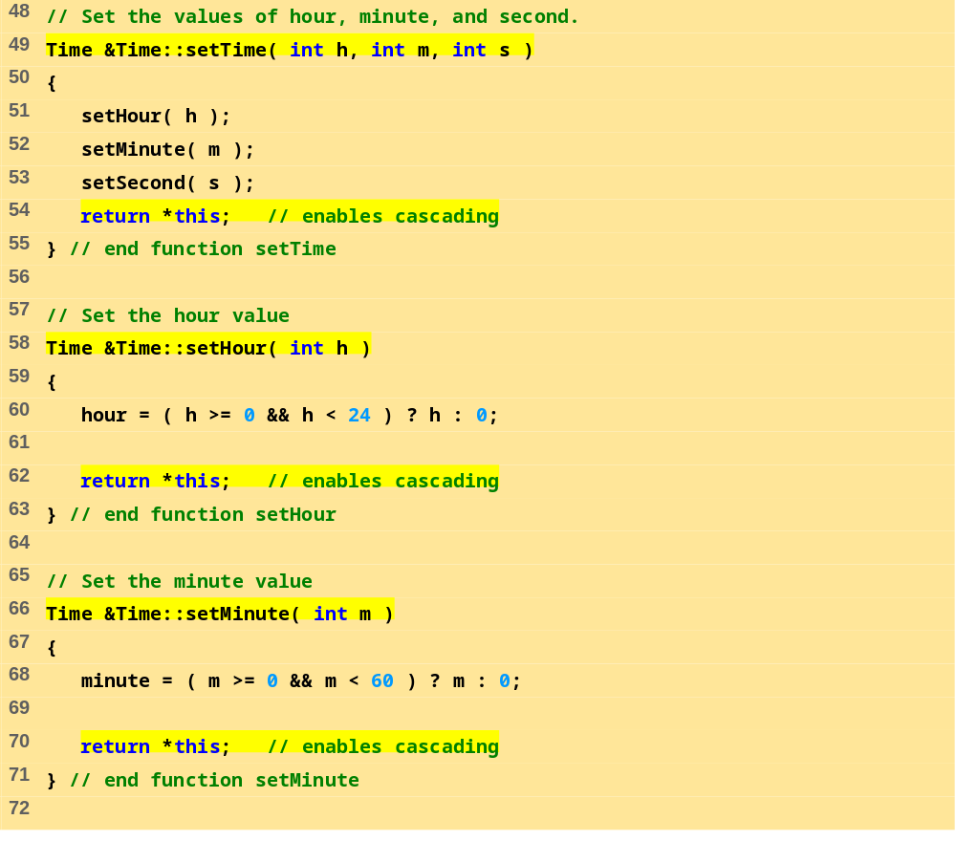
time6.cpp (Part 2 of 3)

Slide 43
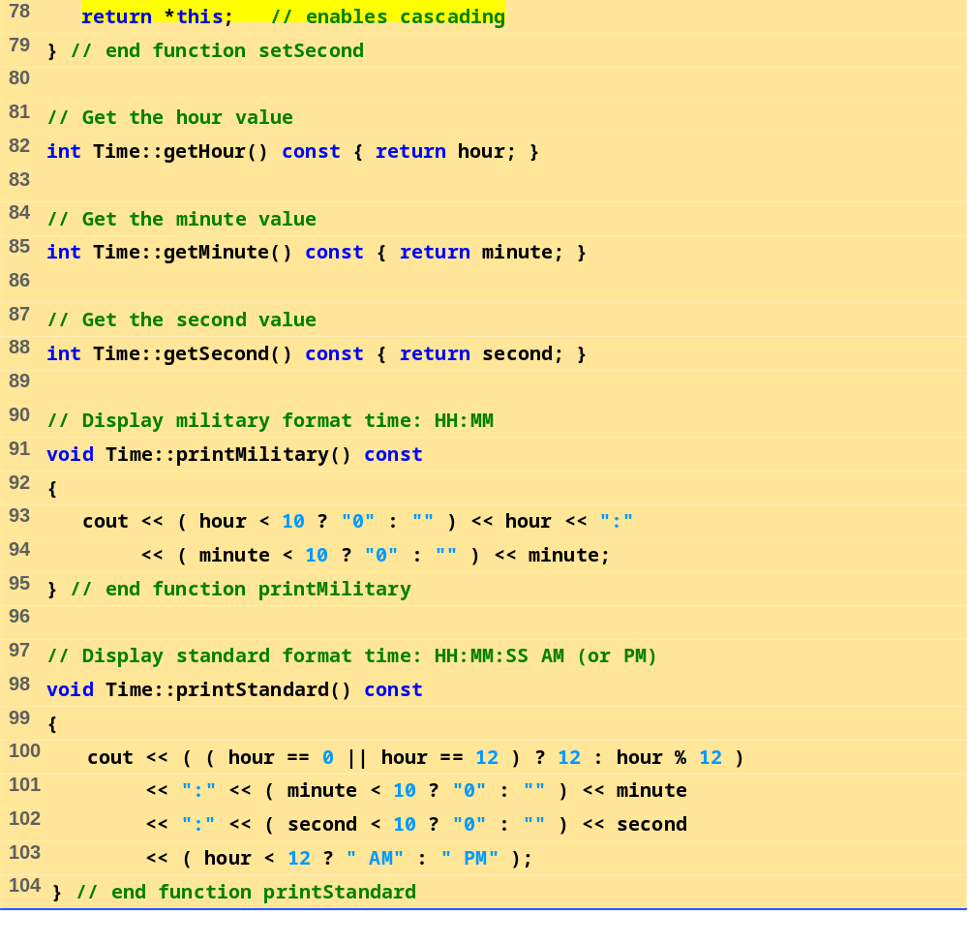
time6.cpp (Part 3 of 3)

Slide 44
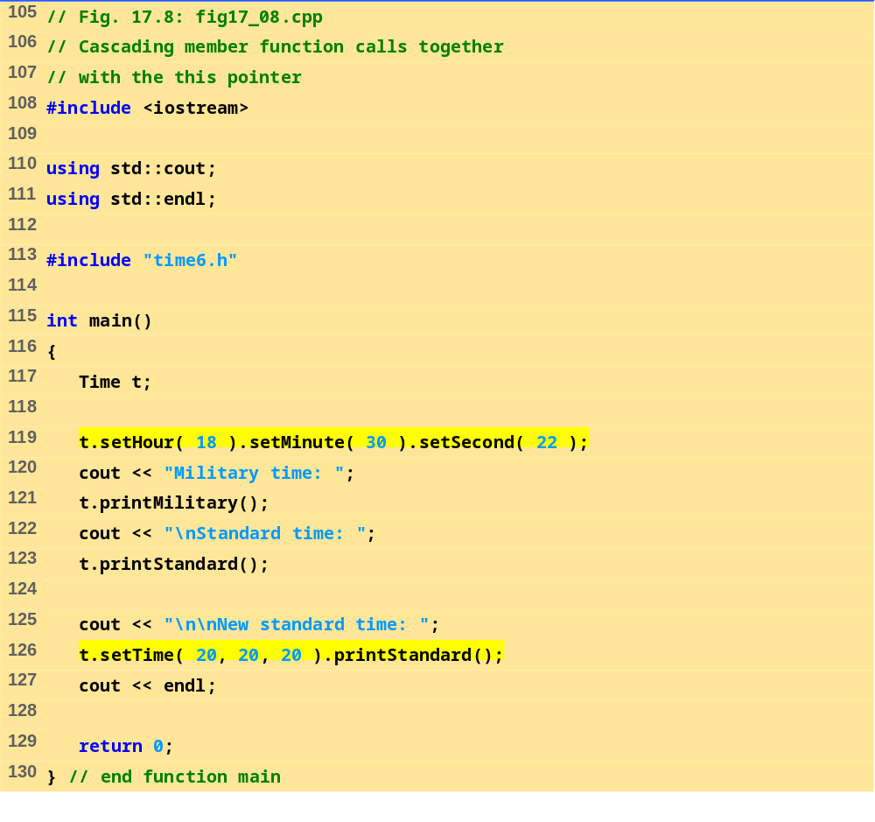
fig17_08.cpp

Slide 45
Military time: 18:30
Standard time: 6:30:22 PM
New standard time: 8:20:20 PM
Program Output

Slide 46
17.6 Dynamic Memory Allocation with Operators new and delete
new and delete
  Better dynamic memory allocation than C’s malloc and free
  new - automatically creates object of proper size, calls constructor, returns pointer of the correct type
  delete - destroys object and frees space
Example:
  TypeName *typeNamePtr;
    Creates pointer to a TypeName object
  typeNamePtr = new TypeName;
    new creates TypeName object, returns pointer (which typeNamePtr is set equal to)
  delete typeNamePtr;
    Calls destructor for TypeName object and frees memory

Slide 47
17.6 Dynamic Memory Allocation with Operators new and delete (II)
Initializing objects
  double *thingPtr = new double( 3.14159 );
  Initializes object of type double to 3.14159
  int *arrayPtr = new int[ 10 ];
  Create ten element int array, assign to arrayPtr.
  Use
    delete [] arrayPtr;
    to delete arrays

Slide 48
17.7 static Class Members
static class members
  Shared by all objects of a class
    Normally, each object gets its own copy of each variable
  Efficient when a single copy of data is enough
    Only the static variable has to be updated
  May seem like global variables, but have class scope
    Only accessible to objects of same class
  Initialized at file scope
  Exist even if no instances (objects) of the class exist
  Can be variables or functions
    public, private, or protected

Slide 49
17.7 static Class Members (II)
Accessing static members
  public static variables: accessible through any object of the class
    Or use class name and (::)
    Employee::count
  private static variables: a public static member function must be used.
    Prefix with class name and (::)
    Employee::getCount()
  static member functions cannot access non-static data or functions
    No this pointer, function exists independent of objects

Slide 50
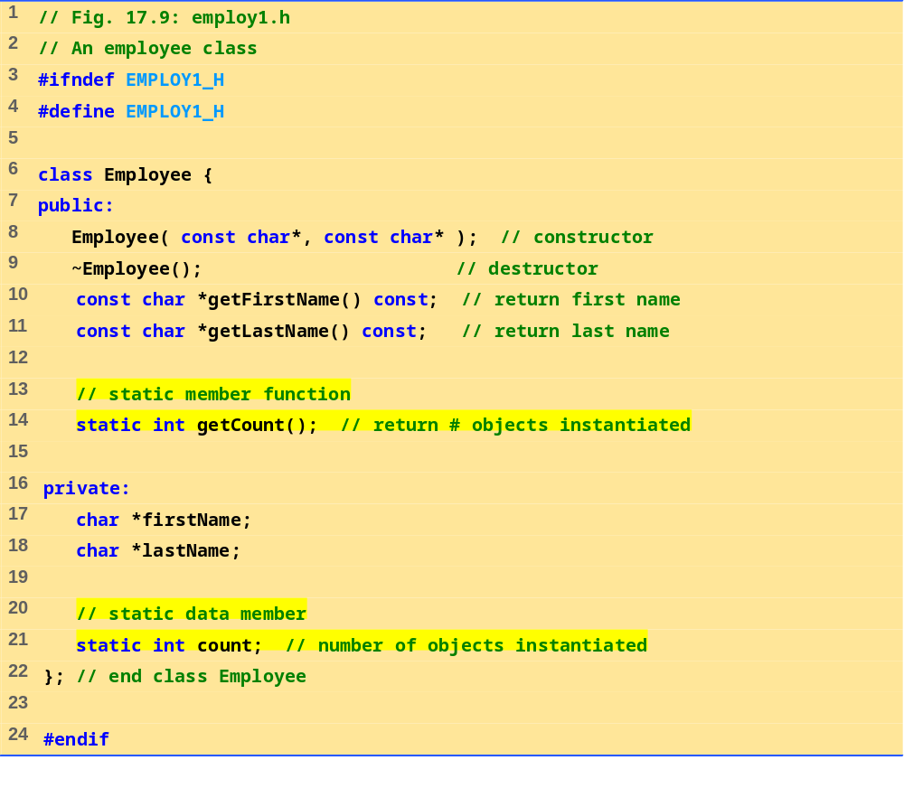
employ.h

Slide 51
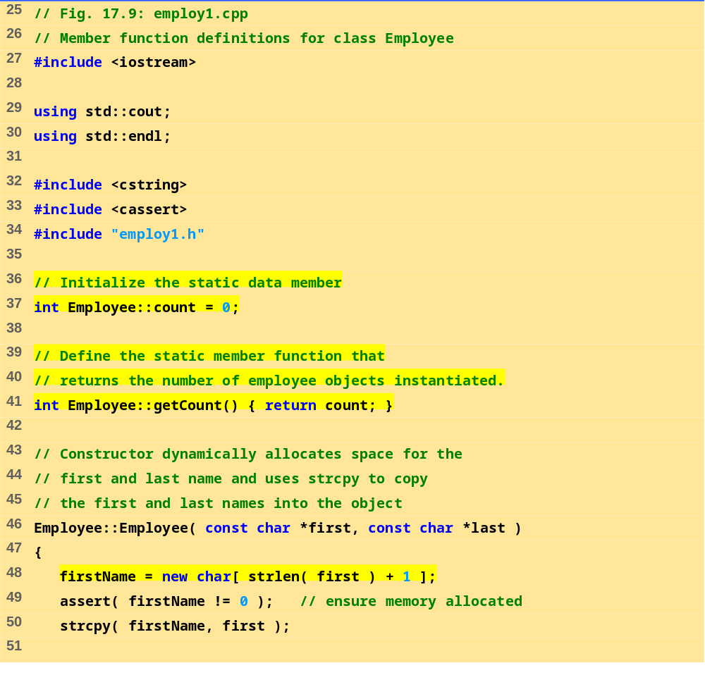
employ.cpp (Part 1 of 3)

Slide 52
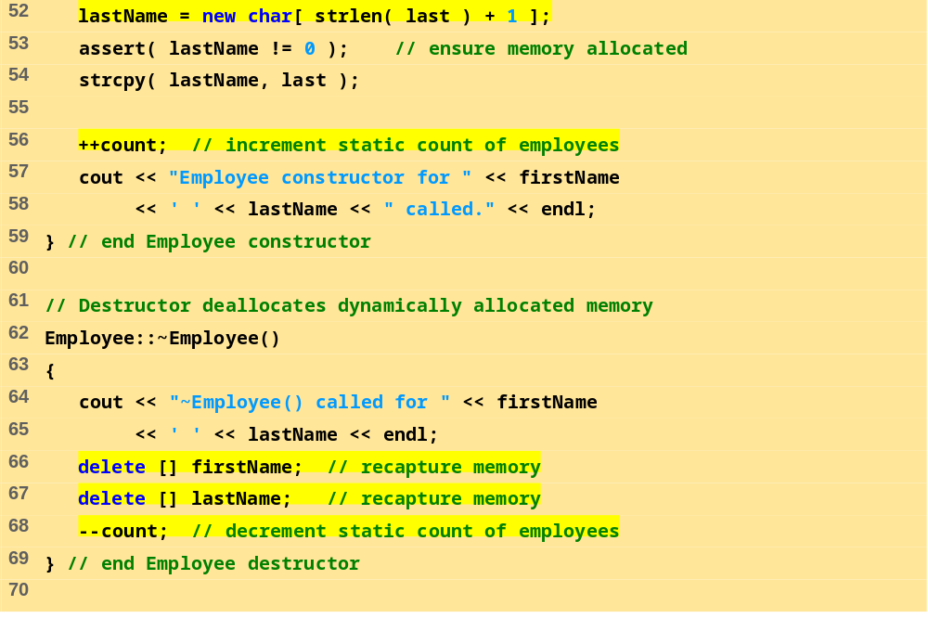
employ.cpp (Part 2 of 3)

Slide 53
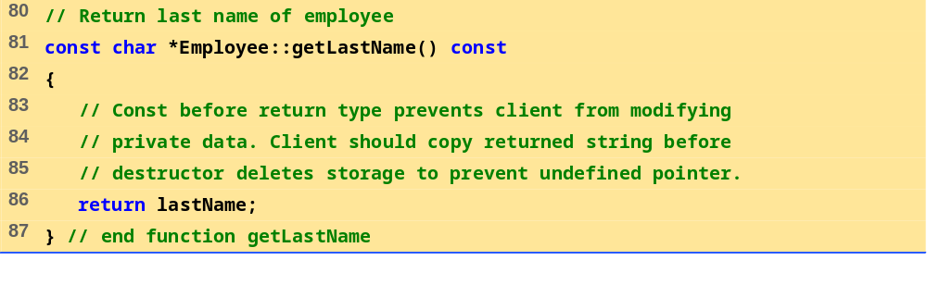
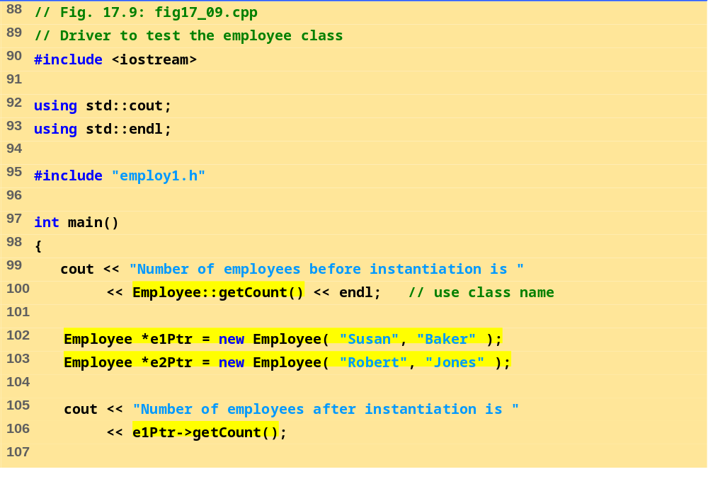
employ.cpp (Part 3 of 3)
fig17_09.cpp (Part 1 of 2)

Slide 54
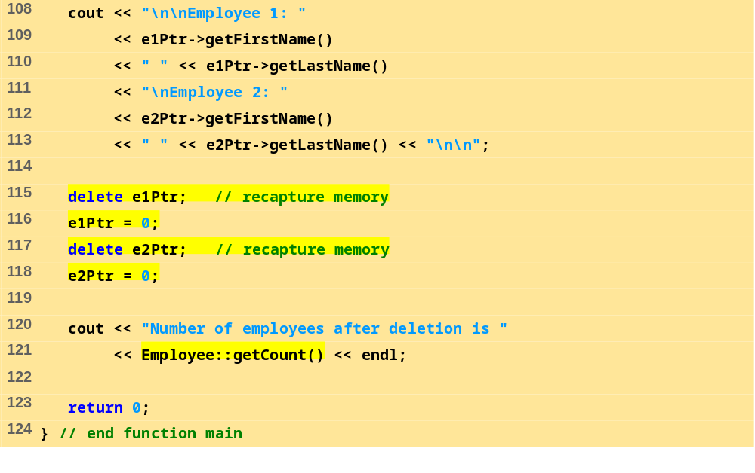
fig17_09.cpp (Part 1 of 2)
Program Output
Number of employees before instantiation is 0
Employee constructor for Susan Baker called.
Employee constructor for Robert Jones called.
Number of employees after instantiation is 2
Employee 1: Susan Baker
Employee 2: Robert Jones
~Employee() called for Susan Baker
~Employee() called for Robert Jones
Number of employees after deletion is 0

Slide 55
17.8 Data Abstraction and Information Hiding
Information hiding
  Classes hide implementation details from clients
  Example: stack data structure
    Data elements like a pile of dishes - added (pushed) and removed (popped) from top
    Last-in, first-out (LIFO) data structure
  Client does not care how stack is implemented, only wants LIFO data structure

Slide 56
17.8 Data Abstraction and Information Hiding (II)
Abstract data types (ADTs)
  Model real world objects
    int, float are models for a number
    Imperfect - finite size, precision, etc.
C++ an extensible language
  Base cannot be changed, but new data types can be created

Slide 57
17.8.1 Example: Array Abstract Data Type
Array
  Essentially a pointer and memory locations
Programmer can make an ADT array
  New capabilities
    Subscript range checking, array assignment and comparison, dynamic arrays, arrays that know their sizes...
New classes
  Proprietary to an individual, to small groups or to companies, or placed in standard class libraries

Slide 58
17.8.2 Example: String Abstract Data Type
C++ intentionally sparse
  Reduce performance burdens
  Use language to create what you need, i.e. a string class
string not a built-in data type
  Instead, C++ enables you to create your own string class

Slide 59
17.8.3 Example: Queue Abstract Data Type
Queue - a waiting line
  Used by computer systems internally
  We need programs that simulate queues
Queue has well-understood behavior
  Enqueue - put things in a queue one at a time
  Dequeue - get those things back one at a time on demand
  Implementation hidden from clients
Queue ADT - stable internal data structure
  Clients may not manipulate data structure directly
  Only queue member functions can access internal data

Slide 60
17.9 Container Classes and Iterators
Container classes (collection classes)
  Classes designed to hold collections of objects
  Services such as insertion, deletion, searching, sorting, or testing an item
  Examples:
  Arrays, stacks, queues, trees and linked lists
Iterator objects (iterators)
  Object that returns the next item of a collection (or some action)
  Can have several iterators per container
    Book with multiple bookmarks
  Each iterator maintains its own “position” information

